Slide 1
Conquer RIC
C₂T₂M

Slide 2
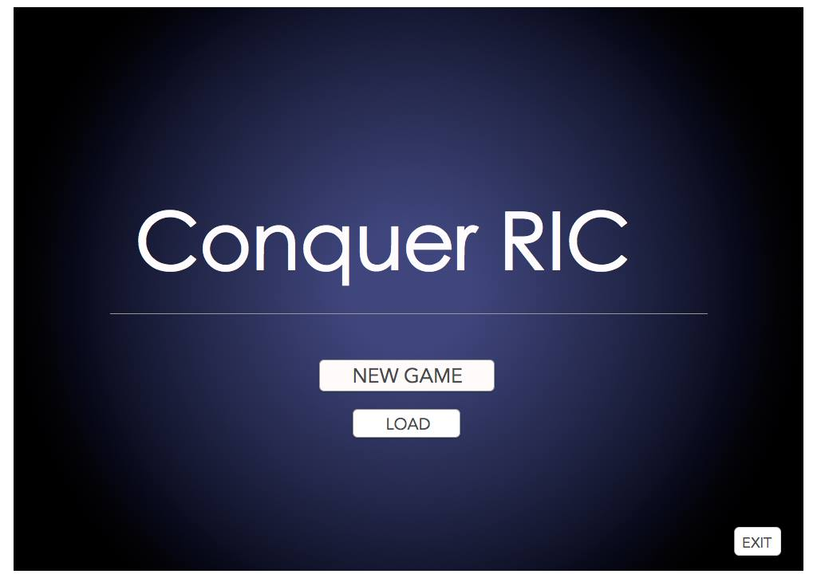
Title Screen

Slide 3
Game Overview
Turn based strategy game
Game objectives
Survival
Elimination
Capture the flag
Arrive at location
Plot
Group of classmates progressing through classes in order to graduate from RIC

Slide 4
Game Overview Cont.
Characters:
Heros
5 heros with options for different classes
Warrior
Hunter
Healer
Rogue
Mage
Enemies
3 normal enemy classes
Warrior (Campus Police)
Hunter (Gardeners/Maintenence)
Healer (Food Staff)
Boss class
Bosses have special abilities/characteristics that make them unique

Slide 5
Game Overview Cont.
Levels
Tutorial Level
Is optional
5 game levels
After beating the 5th level the game is won
Extra Information
Inventory system
Usable items
Equipable items

Slide 6
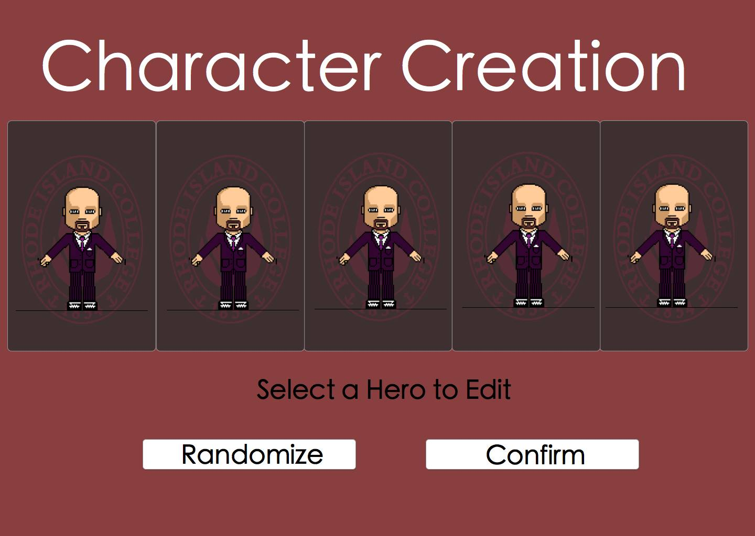
Character Creation Screen

Slide 7
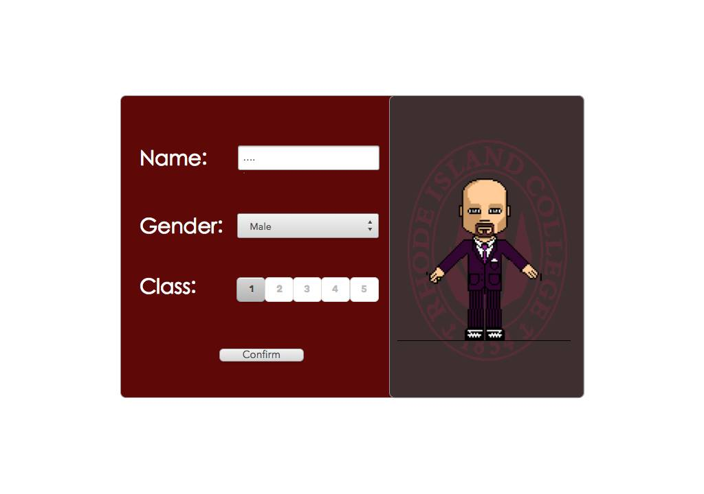
Character Creation

Slide 8
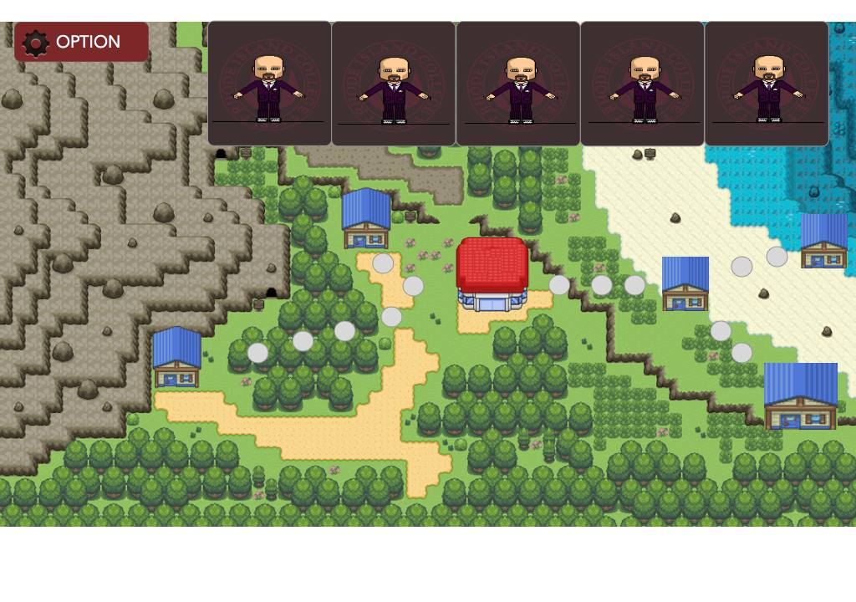
World Map

Slide 9
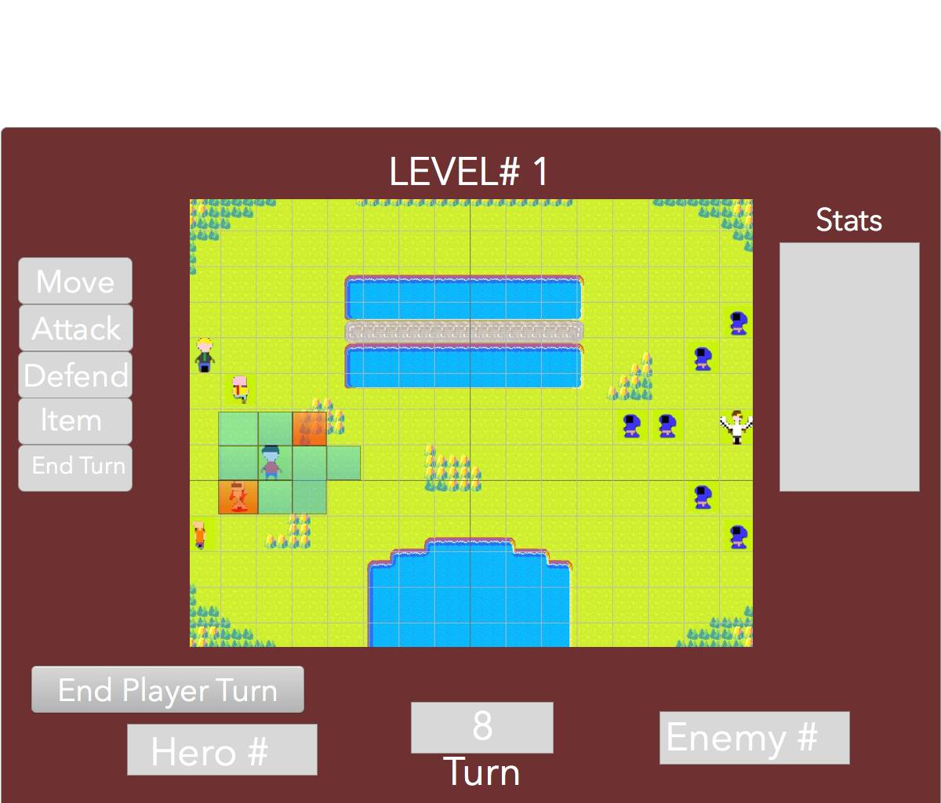
Board Map

Slide 10
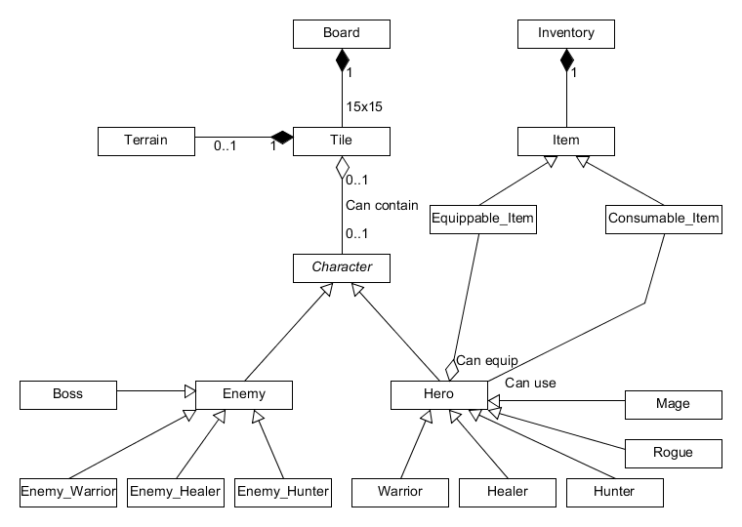
Static Model

Slide 11
Use Cases
High Priority
Being able to move characters from space to space.
Attack enemies.
Load & save game.
End turn button.
Use an item.

Slide 12
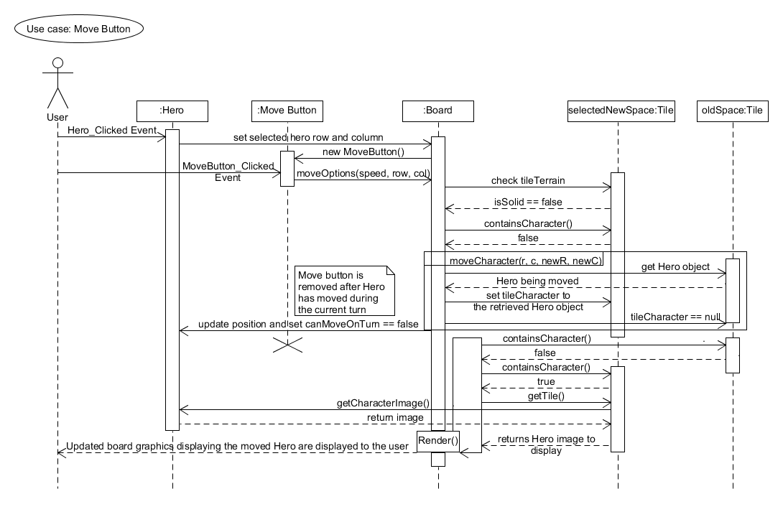
Move Sequence Diagram

Slide 13
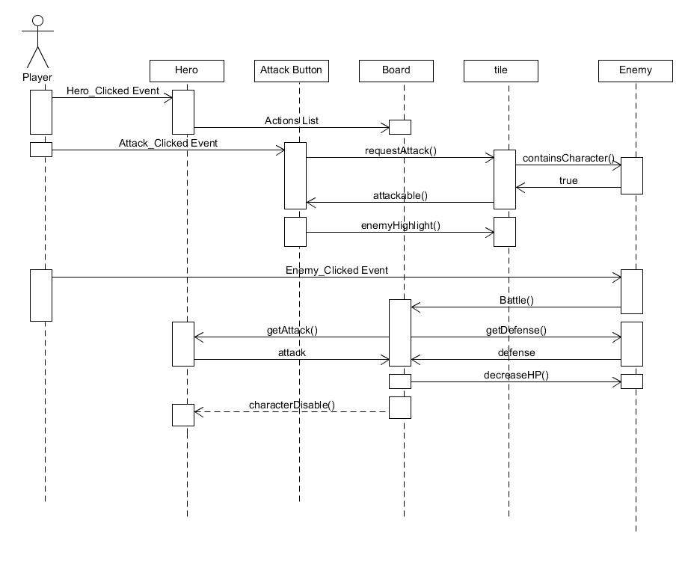
Attack Sequence Diagram

Slide 14
Risk Factors
Enemy AI
Balancing the game so it’s not too easy/hard
Saving and loading game files.
Inventory and an item system.

